Slide 1

Pointer in C/C++ Programming Language

Slide 2
What is a Pointer in C/C++?
A pointer is a variable that stores the memory address of another variable.
Think of it like this:
Normally, variables store values (like a number or a character).
A pointer stores the location in memory where that value is kept.

Slide 3
C/C++ Pointer
Pointers in C are variables that store memory addresses
Advantages:
- Dynamic Memory Allocation
- Direct Memory Access:
- Passing Parameters by Reference
- Manipulating Arrays and Strings
- Efficient Memory Management
- Building Complex Data Structures
Disadvantages:
- Memory Management Issues
- Complexity and Debugging
- Security Risks
- Potential for Undefined Behavior
- Portability Concerns

Slide 4
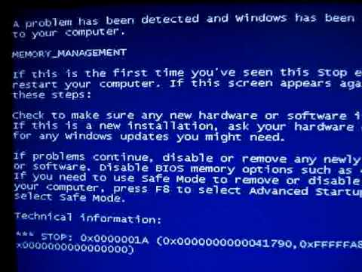
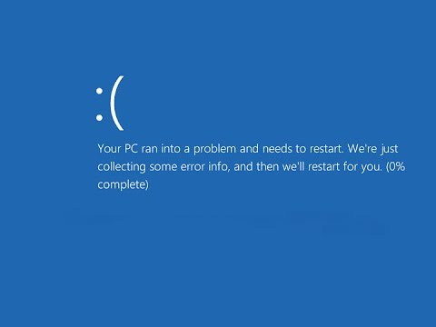

Slide 5
Pointer Syntax
data_type *pointer_name = &variable_name;
data type: This specifies the type of data that the pointer will point to. It could be any valid C data type, such as int, float, char, double, or a custom data type like a struct.
*: The asterisk (*) is used to declare a pointer variable. It tells the compiler that the variable being declared is a pointer.
pointer_name: This is the name of the pointer variable. You can choose any valid C identifier as the pointer's name.
&variable_name: The ampersand (&) operator is used to get the memory address of the variable you want the pointer to point to. It's called the "address-of" operator.

Slide 6
Dereferencing of pointers
Dereferencing of pointers in C is the process of accessing the value stored at a particular memory address to which the pointer is pointing. It allows you to retrieve or modify the data stored at that memory location. Dereferencing is achieved using the unary * operator in C.
int x = 10;
int* ptr = &x; // Pointer ptr points to the memory location of variable x
int value = *ptr; // Dereferencing ptr retrieves the value stored at the memory location it points to
Reading and Writing Values:
Dereferencing allows you to read the value stored at the memory location pointed to by the pointer and also modify that value.
*ptr = 20; // Dereferencing ptr and assigning a new value

Slide 7
Why Do C and C++ Have Pointers?
C was designed for system-level programming (like writing operating systems), so it needs full control of memory.
C++ builds on C and keeps pointers for performance and flexibility.
They give the programmer full power and control, even if it’s risky.
Fundamental concept but also a practical necessity for
Memory management,
Data structures,
System-level programming.
They provide the flexibility needed to build efficient and dynamic applications.

Slide 8
Why Use Pointers?
Pointers are powerful and useful for several reasons:
a) Efficient Memory Use
You can work with large data (like arrays) without copying the whole thing.
b) Dynamic Memory Allocation
You can allocate memory during the program's execution, which is not possible with regular variables.
c) Pass by Reference
You can pass large variables (like arrays or objects) to functions without copying, which saves memory and increases speed.
d) Building Data Structures
You need pointers to build linked lists, trees, graphs, etc.
e) Low-Level Memory Control
Pointers allow direct access to memory, which is helpful in system programming.

Slide 9
When Do You Need to Use Pointers?
Use pointers when:
You want to modify a variable inside a function.
You're working with arrays and strings.
You want to use dynamic memory (new / delete).
You are implementing data structures like linked lists.
You’re doing low-level operations or performance-critical code.

Slide 10
Why Don't Other Languages Use Pointers?
Many modern languages (like Python, Java, etc.) hide pointers from the programmer to:
Make coding easier.
Prevent bugs (pointers can be tricky and unsafe if misused).
Improve security and prevent memory leaks.
These languages use references, which are safe and managed versions of pointers.

Slide 11
Pointers is fundamental feature in C/C++

Slide 12
Pointers is fundamental feature in C/C++
1. Direct Memory Access
Pointers provide direct access to memory addresses, allowing you to read and write data at specific locations. This is particularly useful in system-level programming, where you need to interact with hardware or manage memory manually.
For example, in embedded systems, you might use pointers to control hardware registers directly.
2. Efficiency
Passing large data structures by value can be inefficient because it involves copying the entire structure. By using pointers, you can pass the address of the structure instead, which is much faster and uses less memory.
This is especially important in performance-critical applications like game development or real-time systems.
3. Dynamic Memory Management
Pointers are essential for dynamic memory allocation, which allows you to allocate memory at runtime using functions like malloc and free in C, or new and delete in C++.
This flexibility is crucial for applications that need to handle varying amounts of data, such as databases or multimedia applications.

Slide 13
Pointers is fundamental feature in C/C++
4. Data Structures
Pointers are the backbone of many complex data structures.
Trees: Nodes contain pointers to their children, enabling hierarchical data representation.
Graphs: Pointers can represent edges between nodes, facilitating the implementation of various graph algorithms.
5. Function Pointers
Function pointers allow you to store the address of a function in a variable and call it indirectly. This is useful for implementing callback functions, which are functions that are passed as arguments to other functions and are called at a later time.
This technique is widely used in event-driven programming and for creating flexible APIs.
6. Interfacing with Hardware
In low-level programming, pointers are often used to interface with hardware components. For example, you might use pointers to access memory-mapped I/O registers, which control hardware devices.
This allows you to write drivers and firmware that interact directly with the hardware.

Slide 14
Some of their practical applications of Pointer

Slide 15
Some of their practical applications:
**Dynamic Memory Allocation**
**Data Structures and Algorithms**
**Function Pointers**
**Accessing Array Elements**
**Passing Arguments by Reference**
**String Manipulation**
**File I/O**
**Structures and Unions**
**Interfacing with Hardware and System Calls**
**Pointer Arithmetic and Optimization**

Slide 16
When Do You Need to Use Pointers?
Use pointers when:
You want to modify a variable inside a function.
You're working with arrays and strings.
You want to use dynamic memory (new / delete).
You are implementing data structures like linked lists.
You’re doing low-level operations or performance-critical code.

Slide 17
**Dynamic Memory Allocation**
One of the most powerful uses of pointers in C/CPP is for **dynamic memory allocation**.
Unlike static memory allocation (where memory is allocated at compile time), dynamic memory allocation allows you to allocate memory at runtime using functions like `malloc`, `calloc`, and `realloc`.
This flexibility is crucial for creating data structures, managing large arrays, and handling variable-sized data.

Slide 18
**Data Structures and Algorithms**
Pointers are fundamental for implementing various data structures such as linked lists, trees, graphs, and hash tables.
Algorithms like depth-first search (DFS), breadth-first search (BFS), and dynamic programming often rely on pointers for efficient memory management.

Slide 19
**Function Pointers**
Function pointers allow you to call functions dynamically at runtime.
They are used for implementing callback mechanisms, switching behavior, and creating generic function interfaces.
For example, sorting functions like `qsort` use function pointers to compare elements.

Slide 20

**Accessing Array Elements**
Pointers provide a way to access array elements efficiently.
- By using pointer arithmetic, you can iterate through arrays, manipulate elements, and perform array-related operations.

Slide 21
**Passing Arguments by Reference**
Pointers allow you to pass arguments by reference to functions.
When you pass a pointer to a function, any changes made to the pointed data inside the function affect the original data outside the function.

Slide 22
**String Manipulation**
Strings in C are represented as character arrays, and pointers play a crucial role in string manipulation.
Functions like `strcpy`, `strcat`, and `strlen` operate on pointers to characters.

Slide 23
**File I/O**
Pointers are used extensively for file input/output operations.
Functions like `fread`, `fwrite`, and `fseek` work with file pointers.

Slide 24
**Structures and Unions**
Pointers allow you to create complex data structures using structures and unions.
You can dynamically allocate memory for structures and access their members using pointers.

Slide 25
**Interfacing with Hardware and System Calls**
In low-level programming, pointers are used to interface with hardware devices and system calls.
Device drivers, memory-mapped I/O, and direct memory access (DMA) rely on pointers.

Slide 26

**Pointer Arithmetic and Optimization**
Pointers enable efficient memory traversal and manipulation.
Techniques like pointer arithmetic, pointer casting, and pointer-to-void are used for optimization.

Slide 27
Memory Reusability-Pointer
Using Pointers (Manually Reusing Memory)
You can use a pointer to a single memory location and reinterpret it as different variables at different times:
#include <stdio.h>
int main()
{ int a = 0; int* x = &a;
*x = 10; // Use as variable A printf("A: %d\n", *x);
*x = 20; // Use as variable B printf("B: %d\n", *x);
*x = 30; // Use as variable C printf("C: %d\n", *x);
return 0;
}
In this case, you're just reusing the same variable (a) and calling it A, B, C logically at different times.
Using Pointer concept in C and C++, it is possible to reuse the same memory location for multiple variables at different points in time to save memory, but this must be done carefully to avoid undefined behavior

Slide 28
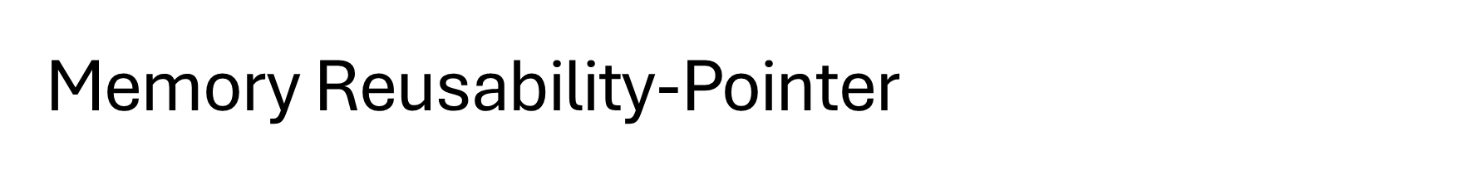
Using union (Preferred Way)
A union in C/C++ allows you to store different data types in the same memory location, one at a time. This is exactly what you’re asking for.
Example:
#include <stdio.h>
union ReuseMemory {
int A;
int B;
int C;
int D;
};
int main() {
union ReuseMemory u;
u.A = 5; printf("A: %d\n", u.A);
u.B = 10; printf("B: %d\n", u.B);
u.C = 15; printf("C: %d\n", u.C);
u.D = 20; printf("D: %d\n", u.D);
return 0; }
Here, only one value is valid at a time, and all variables (A, B, C, D) share the same memory (typically 4 bytes for int).
So instead of 4 × 4 = 16 bytes, it only uses 4 bytes total.
Memory reuse by pointers in C and C++ involves using the same memory location for different purposes at different times, which helps in optimizing memory usage. Here are some key aspects:
Dynamic Memory Allocation: You can allocate memory dynamically using functions like malloc, calloc, realloc in C, and new and delete in C++. This allows you to allocate memory as needed and free it when it's no longer required, making the same memory available for other uses.
Pointer Reassignment: A pointer can be reassigned to point to different variables or memory locations at different times. This means you can use the same pointer to access different data without needing additional memory allocations.

Slide 29
Memory Reusability-Pointer
Important Notes:
You must manage the lifetime and usage of these variables to avoid bugs.
Don't access multiple union members at once unless they are of the same type and layout (strict aliasing rule).
This technique is useful in embedded systems or memory-constrained environments.

Slide 30
Output (Expected):
As int: 42
As float: 3.14
As string: Hello
But remember:
Only the last assigned member is valid.
Accessing a previous type after writing a new one is undefined behavior (i.e., might give garbage or crash).
Example: Reusing Memory for Different Types
#include <stdio.h>
#include <string.h>
union_Data {
int i;
float f;
char str[20];
};
int main()
{ union_Data data;
data.i = 42;
printf("As int: %d\n", data.i);
data.f = 3.14;
printf("As float: %.2f\n", data.f);
strcpy(data.str, "Hello");
printf("As string: %s\n", data.str);
return 0;
}
Memory Usage:
The total size of the union is equal to the size of its largest member. In this case:
int = 4 bytes
float = 4 bytes
char[20] = 20 bytes
So, the whole union takes only 20 bytes, not 28 bytes, saving 8 bytes.

Slide 31

Different types of Pointer

Slide 32
Different types of Pointer-Null Pointer
#include <stdio.h>
int main() {
int *ptr = NULL; // Initialize the pointer to NULL
if (ptr == NULL) {
printf("The pointer is null and does not point to any valid memory location.\n");
}
int a = 10;
ptr = &a; // Assign the pointer to the address of variable a
if (ptr != NULL) {
printf("The pointer now points to the value: %d\n", *ptr);
}
return 0;
}
A null pointer is a special pointer value that points to nothing or no valid memory location. In C and C++, a null pointer is typically used to indicate that the pointer is not currently assigned to any valid memory address.
Represents a pointer that doesn't point to any valid memory location.Used to indicate the end of a list or to signal an error condition.

Slide 33
#include <iostream>
int main() {
int *ptr = nullptr; // Initialize the pointer to nullptr
if (ptr == nullptr) {
std::cout << "The pointer is null and does not point to any valid memory location." << std::endl;
}
int a = 10;
ptr = &a; // Assign the pointer to the address of variable a
if (ptr != nullptr) {
std::cout << "The pointer now points to the value: " << *ptr << std::endl;
}
return 0;
}
Program demonstrating the use of a null pointer in C++

Slide 34
Void Pointer
#include <iostream>
int main() {
int a = 10;
float b = 20.5;
char c = 'A';
void *ptr; // Declare a void pointer
ptr = &a; // Point to an integer
std::cout << "Value of a: " << *(static_cast<int *>(ptr)) << std::endl; // Cast to int pointer before dereferencing
ptr = &b; // Point to a float
std::cout << "Value of b: " << *(static_cast<float *>(ptr)) << std::endl; // Cast to float pointer before dereferencing
ptr = &c; // Point to a char
std::cout << "Value of c: " << *(static_cast<char *>(ptr)) << std::endl; // Cast to char pointer before dereferencing
return 0;
}
A void pointer, also known as a generic pointer, is a special type of pointer in C and C++ that can point to any data type. It is declared using the void keyword, and because it doesn't have a specific data type, it can be used to store the address of any variable, regardless of its type. However, you cannot directly dereference a void pointer or perform pointer arithmetic on it without first casting it to another pointer type.

Slide 35
Void Pointer
#include <stdio.h>
int main() {
int a = 10;
float b = 20.5;
char c = 'A';
void *ptr; // Declare a void pointer
ptr = &a; // Point to an integer
printf("Value of a: %d\n", *(int *)ptr); // Cast to int pointer before dereferencing
ptr = &b; // Point to a float
printf("Value of b: %.2f\n", *(float *)ptr); // Cast to float pointer before dereferencing
ptr = &c; // Point to a char
printf("Value of c: %c\n", *(char *)ptr); // Cast to char pointer before dereferencing
return 0;
}
Key Points:
Declaration: void *ptr;
Assignment: You can assign the address of any variable to a void pointer.
Casting: Before dereferencing a void pointer, you must cast it to the appropriate type.
Void pointers are useful for creating functions that can handle different data types, such as generic functions for memory management or data manipulation.

Slide 36
Wild Pointer
#include <stdio.h>
int main()
{
int *ptr; // Declare a pointer without initializing it (wild pointer)
// Attempting to dereference a wild pointer (undefined behavior)
// printf("Value at ptr: %d\n", *ptr);
// This line can cause a crash
int a = 10;
ptr = &a; // Initialize the pointer to a valid address
printf("Value at ptr: %d\n", *ptr); // Now it's safe to dereference
return 0;
}
A wild pointer in C and C++ is a pointer that has not been initialized to a valid memory address. Using a wild pointer can lead to undefined behavior, including crashes and data corruption, because it may point to an arbitrary memory location.

Slide 37
Wild Pointer
#include <iostream>
int main() {
int *ptr; // Declare a pointer without initializing it (wild pointer)
// Attempting to dereference a wild pointer (undefined behavior)
// std::cout << "Value at ptr: " << *ptr << std::endl; // This line can cause a crash
int a = 10;
ptr = &a; // Initialize the pointer to a valid address
std::cout << "Value at ptr: " << *ptr << std::endl; // Now it's safe to dereference
return 0;
}
Key Points:
Declaration: A pointer declared without initialization is a wild pointer.
Undefined Behavior: Dereferencing a wild pointer can lead to crashes or data corruption.
Initialization: Always initialize pointers before using them to avoid wild pointers.
To avoid wild pointers, always initialize your pointers either to NULL (or nullptr in C++) or to a valid memory address before using them

Slide 38
Dangling Pointer
#include <stdio.h>
#include <stdlib.h>
int main() {
int *ptr = (int *)malloc(sizeof(int)); // Allocate memory
*ptr = 10;
printf("Value: %d\n", *ptr);
free(ptr); // Free the allocated memory
// ptr is now a dangling pointer
// Attempting to dereference a dangling pointer (undefined behavior)
// printf("Value after free: %d\n", *ptr); // This line can cause a crash
ptr = NULL; // Avoid dangling pointer by setting it to NULL
return 0;
}
A dangling pointer in C and C++ is a pointer that continues to reference a memory location after the memory has been freed or deallocated. Using a dangling pointer can lead to undefined behavior, including crashes and data corruption, because the memory it points to may be reused for other purposes.
Causes of Dangling Pointers:
Deallocation: When memory is freed using free (in C) or delete (in C++), any pointer that was pointing to that memory becomes a dangling pointer.
Scope Exit: When a local variable goes out of scope, any pointer pointing to it becomes a dangling pointer.

Slide 39
Dangling Pointer in C++
#include <iostream>
int main() {
int *ptr = new int; // Allocate memory
*ptr = 10;
std::cout << "Value: " << *ptr << std::endl;
delete ptr; // Free the allocated memory
// ptr is now a dangling pointer
// Attempting to dereference a dangling pointer (undefined behavior)
// std::cout << "Value after delete: " << *ptr << std::endl; // This line can cause a crash
ptr = nullptr; // Avoid dangling pointer by setting it to nullptr
return 0;
}
Key Points:
Deallocation: Freeing memory makes any pointer to that memory a dangling pointer.
Undefined Behavior: Dereferencing a dangling pointer can lead to crashes or data corruption.
Avoidance: Set pointers to NULL (or nullptr in C++) after freeing memory to avoid dangling pointers.
To prevent dangling pointers, always ensure that pointers are set to NULL or nullptr after the memory they point to has been deallocated.

Slide 40
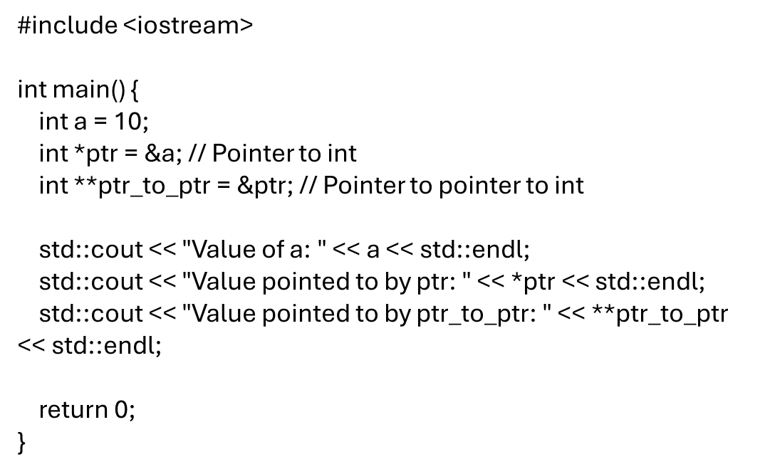
Pointer to Pointer
#include <stdio.h>
int main()
{
int a = 10;
int *ptr = &a; // Pointer to int
int **ptr_to_ptr = &ptr; // Pointer to pointer to int
printf("Value of a: %d\n", a);
printf("Value pointed to by ptr: %d\n", *ptr);
printf("Value pointed to by ptr_to_ptr: %d\n", **ptr_to_ptr);
return 0;
}
A pointer to a pointer, also known as a double pointer, is a pointer that stores the address of another pointer. This allows for multiple levels of indirection, which can be useful in various scenarios, such as dynamic memory allocation for multi-dimensional arrays, passing pointers to functions, and managing complex data structures.

Slide 41
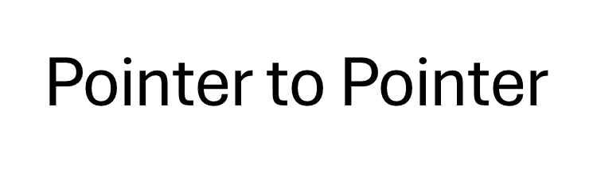
Dynamic Memory Allocation: When allocating memory for multi-dimensional arrays, double pointers are often used.
Passing Pointers to Functions: Double pointers allow functions to modify the value of a pointer passed to them.
int **array;
int rows = 3, cols = 4;
array = (int **)malloc(rows * sizeof(int *));
for (int i = 0; i < rows; i++) {
array[i] = (int *)malloc(cols * sizeof(int));
}
void allocateMemory(int **ptr) {
*ptr = (int *)malloc(sizeof(int));
**ptr = 100;
}
int main() {
int *ptr = NULL;
allocateMemory(&ptr);
printf("Value: %d\n", *ptr);
free(ptr);
return 0;
}
Complex Data Structures: Managing linked lists, trees, and other complex data structures often involves double pointers.
Using pointers to pointers provides flexibility and control over memory and data structures, making them a powerful tool in C and C++ programming.

Slide 42
Array of Pointer
#include <stdio.h>
int main() {
const char *arr[] = {"Hello", "World", "Array", "of", "Pointers"};
int size = sizeof(arr) / sizeof(arr[0]);
for (int i = 0; i < size; i++) {
printf("%s\n", arr[i]);
}
return 0;
}
An array of pointers is a collection of pointers, where each element in the array is a pointer that can point to a variable or an array of variables. This concept is useful for managing multiple strings, arrays, or dynamically allocated memory blocks.
#include <iostream>
int main() {
const char *arr[] = {"Hello", "World", "Array", "of", "Pointers"};
int size = sizeof(arr) / sizeof(arr[0]);
for (int i = 0; i < size; i++) {
std::cout << arr[i] << std::endl;
}
return 0;
}

Slide 43
Array of Pointer
Key Points:
Declaration: An array of pointers is declared by specifying the pointer type followed by the array notation.
int *arr[5]; // Array of 5 integer pointers
Initialization: Each element in the array can be assigned the address of a variable or a dynamically allocated memory block.
int a = 10, b = 20, c = 30;
int *arr[3];
arr[0] = &a;
arr[1] = &b;
arr[2] = &c;
Usage: You can access the values pointed to by the pointers using dereferencing.
for (int i = 0; i < 3; i++) {
printf("Value at arr[%d]: %d\n", i, *arr[i]);
}

Slide 44
Purpose:
Managing Strings: Arrays of pointers are commonly used to manage multiple strings.
Dynamic Memory: They are useful for handling dynamically allocated arrays or structures.
Function Arguments: Arrays of pointers can be passed to functions to handle multiple data items.
Using arrays of pointers provides flexibility in managing collections of data, especially when dealing with strings or dynamically allocated memory.
Array of Pointer

Slide 45
Pointer Arithmetic
Pointer arithmetic in C involves performing arithmetic operations on pointers to navigate through memory locations.
Pointer arithmetic is primarily used for traversing arrays, accessing individual elements, and iterating over data structures like arrays and strings.
#include <stdio.h>
int main() {
int arr[] = {1, 2, 3, 4, 5}; // Define an array of integers
int *ptr = arr; // Declare a pointer to the first element in the array
// Access elements using pointer arithmetic
for (int i = 0; i < 5; ++i) {
printf("%d ", *(ptr + i)); // Equivalent to arr[i]
}
return 0;
}
Pointer Arithmetic
Incrementing a Pointer
Decrementing a Pointer
Pointer Subtraction
Pointer Addition and Subtraction

Slide 46
Smart Pointer
A smart pointer is a type of pointer provided by modern programming languages, particularly C++, that automatically manages the memory of the object it points to. Unlike regular pointers, smart pointers help prevent memory leaks and dangling pointers by ensuring that the memory is properly deallocated when the smart pointer goes out of scope.

Slide 47
Near Pointer
Near pointers are a concept from older programming models, particularly in the context of DOS and Windows 16-bit environments. They are not commonly used in modern C and C++ programming, but understanding them can be useful for historical context or working with legacy code.
Far Pointer
Legacy type for 16-bit compilers, used to access data outside the current segment.Not commonly used in modern C.
Huge Pointer
Legacy type for 16-bit compilers, used to access data in a 64KB segment different from the current one. Rarely used in modern C.

